Slide 1
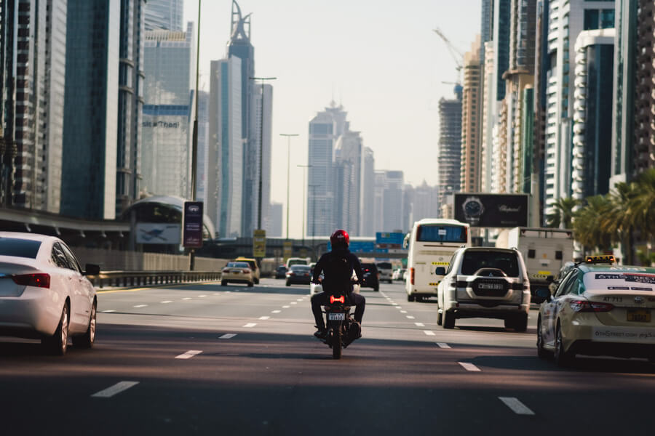
Problem definition

Slide 2
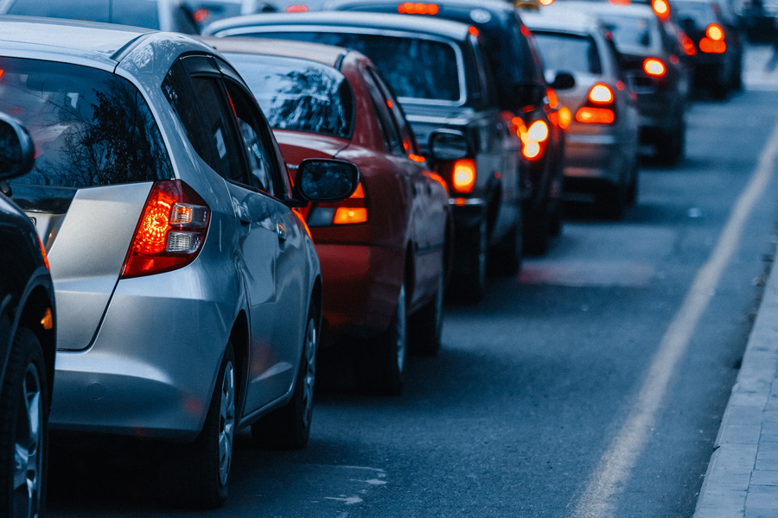
Problem Definition
Road gates force cars to stop to take cash, and some days the road is crowded, and these gates are the cause of road congestion. This causes problems for many citizens because they are late for their important appointments.

Slide 3
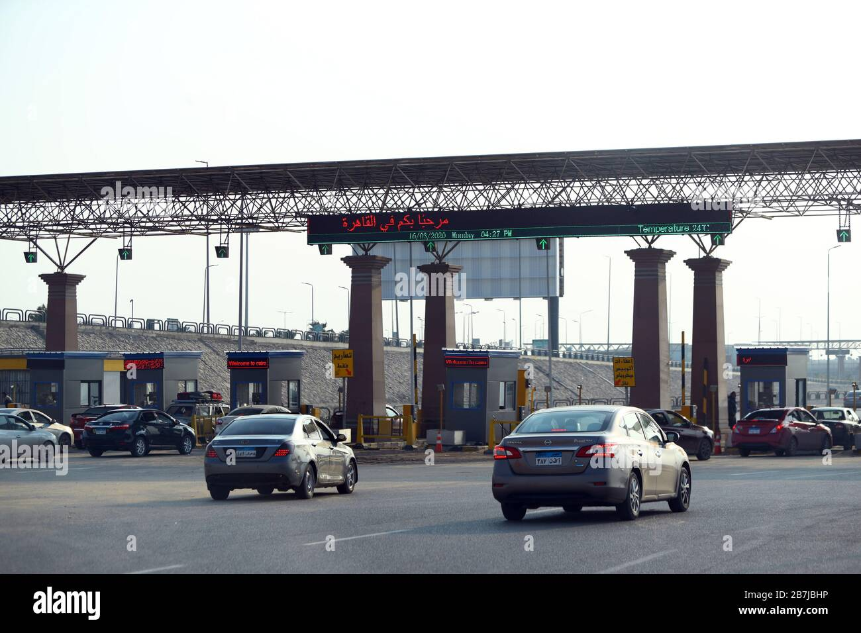
Problem Definition
Also we do not need such procedures that we can replace with an automated system. The state also imposes construction and operating costs and salaries of employees and soldiers for protection. In cases of car theft, we cannot identify them

Slide 4
Project objective

Slide 5
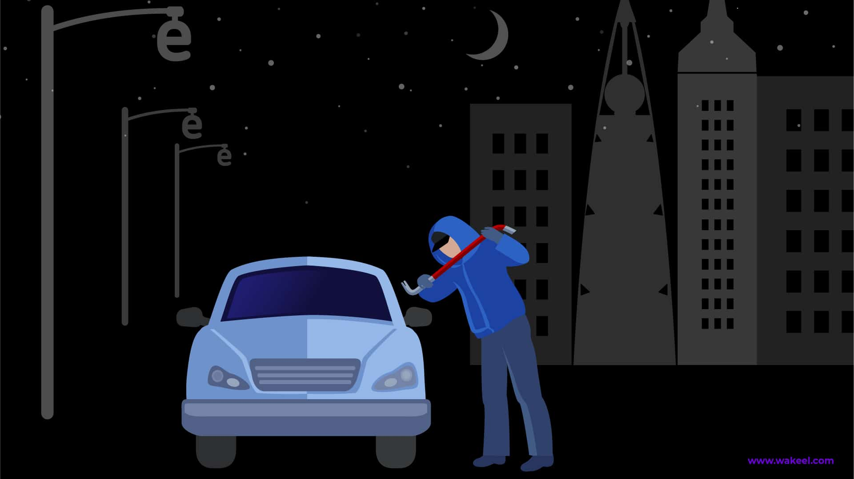
cars do not need to stop and there will be no congestion on the road, We will reduce traffic congestion
We can identify stolen cars
We can also integrate this system into state agencies to track and trace stolen vehicles

Slide 6
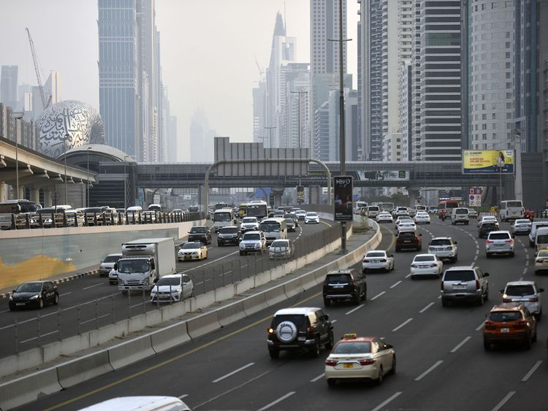
Thank you!

